Slide 1
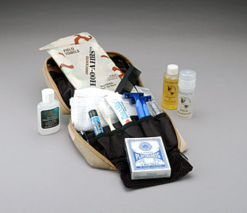
Learning Activity 3.6.2
Image 1
Radios
I.D Cards
Passports/ LP
Money
Water
First Aid Kit
Run bag
UN Core Pre-Deployment Training Materials 2017

Slide 2
Learning Activity 3.6.2
Image 2
UN Core Pre-Deployment Training Materials 2017

Slide 3
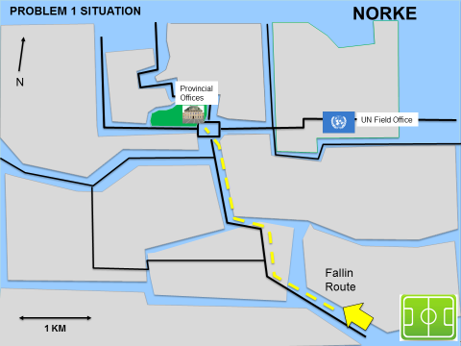
Learning Activity 3.6.3
Map
SCENARIO: POTENTIALLY VIOLENT DEMONSTRATION
TOWN Q
Group 2
Route
UN Core Pre-Deployment Training Materials 2017

Slide 4
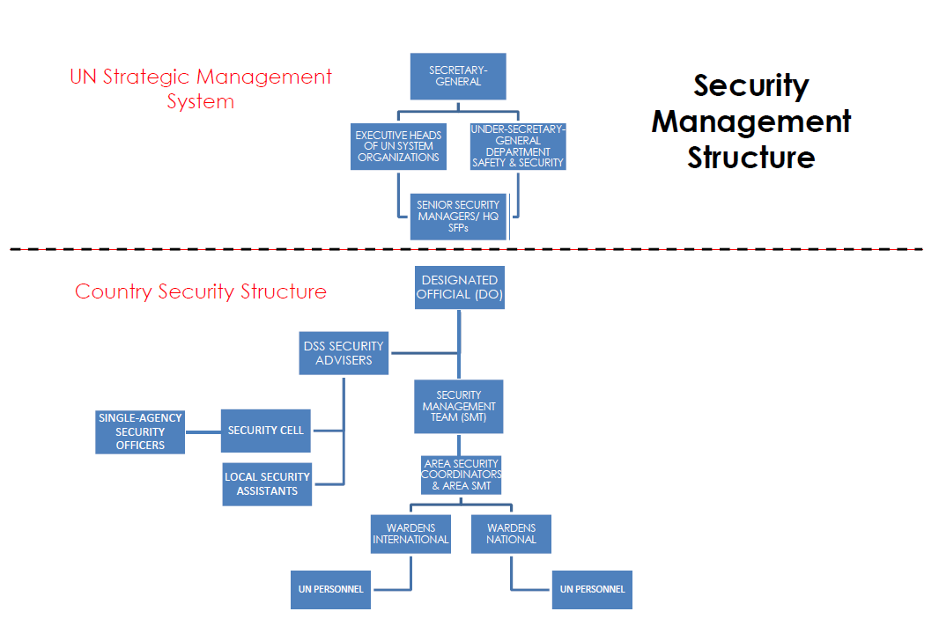
Learning Activity 3.6.4
Diagram
UN Core Pre-Deployment Training Materials 2016
UN Core Pre-Deployment Training Materials 2017

